Slide 1

Secure banking application in cloud using Continuous authentication
Batch No: A-05 Project Guide:
D.Lakshmi (164G1A0544) Mrs.M.Soumya, M.Tech.
M. Archana (164G1A0507) Assistant Professor`
M.Mani Chaitanya (164G1A0552)
V.Divya (164G1A0524)
Srinivasa Ramanujan Institute of Technology
Department of Computer Science & Engineering

Slide 2
Github link:
https://github.com/Lakshmi544-lab/A5-SRIT-2020

Slide 3
Abstract
Cloud computing denotes an IT infrastructure where data and software are stored and processed remotely in a data center of a cloud provider, which are accessible via an Internet service.
Session management in distributed Internet services is traditionally based on username and password, which allows a single verification.
A secure protocol is defined for authentication through continuous user verification.

Slide 4
Existing System:
Once the user’s identity has been verified, the system resources are available for a fixed period of time or until explicit logout from the user. This approach assumes that a single verification (at the beginning of the session) is sufficient, and that the identity of the user is constant during the whole session.
The disadvantage of existed System is none of existing approaches supports continuous authentication.

Slide 5
Proposed System
This paper presents a new approach for user verification and session management that is applied on the Internet.
The Proposed System is able to operate securely with any kind of web service, including services with high security demands as online banking services, and it is intended to be used from different client devices, e.g., smartphones, Desktop PCs .
Our continuous authentication approach is grounded on acquisition of adaptive timeout management.

Slide 6
Modules
System Model
Image Verification
Continuous Authentication
Authentication Server

Slide 7
System Model
"User Id" refers to the identity of the user obtained from the Bank for the purpose of logging into the Internet Banking facility provided by the Bank.
"Login Password" is a unique and randomly generated password known only to the customer, which can be changed by the user to his/her convenience. This is a means of authenticating the user ID for logging into Internet Banking.

Slide 8
Continued….
"Transaction Password" is a unique and randomly generated password known only to the customer, which can be changed to his/her convenience. This is a means of authentication required to be provided by the customer for putting through the transaction in their its accounts with Bank through Internet Banking. While User ID and Password are for valid access into the internet application, giving valid Transaction Password is for authentication of transaction through internet.

Slide 9
Image verification
In this module ,we verify the name of the image and if it matches it opens the user module and if it doesnot match then it displays doesnot match.

Slide 10
Continuous Authentication
A secure protocol is defined for authentication through continuous user verification. The protocol determines adaptive timeouts based on the quality, frequency and type of biometric data transparently acquired from the user.

Slide 11
Authentication Server
The Server maintains the functionality:
Customer Details
Activation of Beneficiary
Transaction Details
Activate Blocked Account

Slide 12
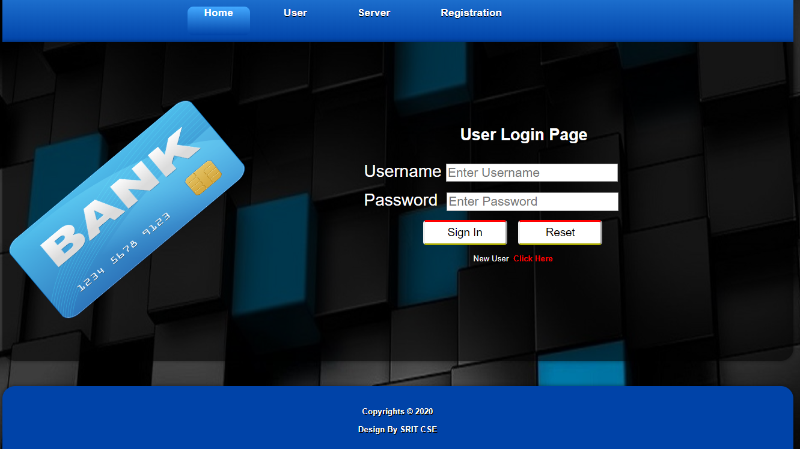
Outputs:

Slide 13
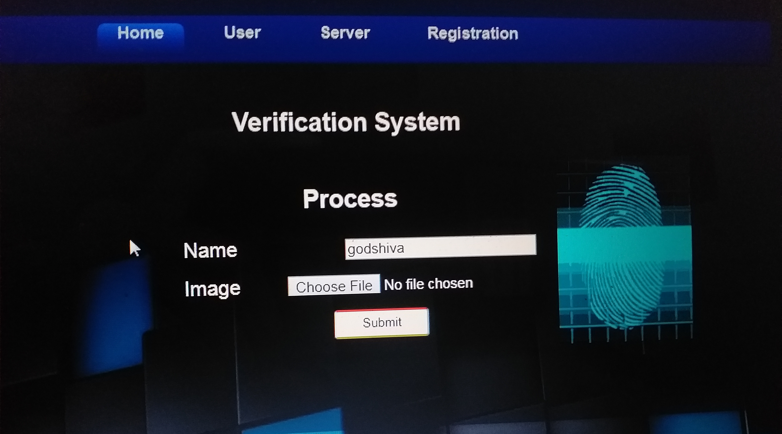
Contd..

Slide 14
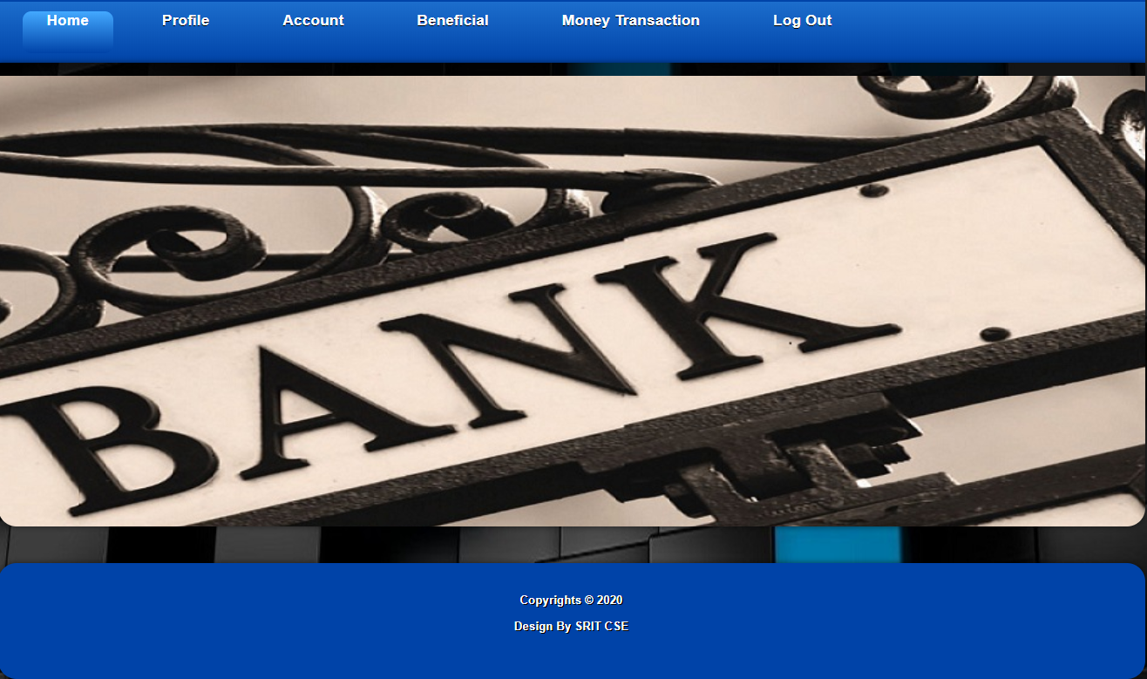
Contd..

Slide 15
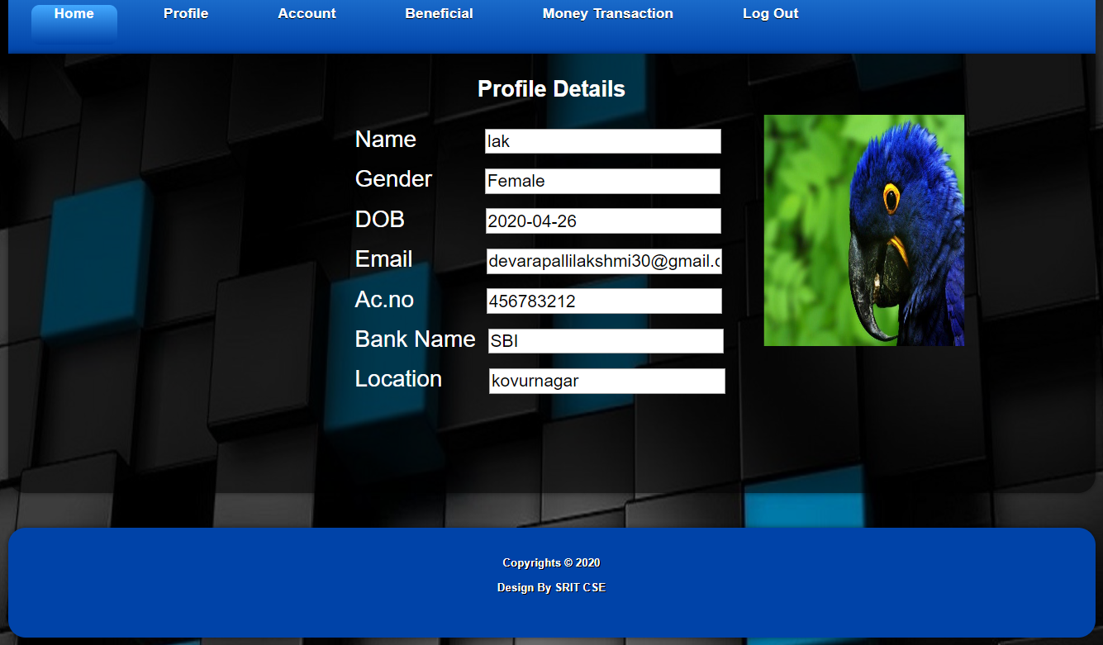
Contd..

Slide 16
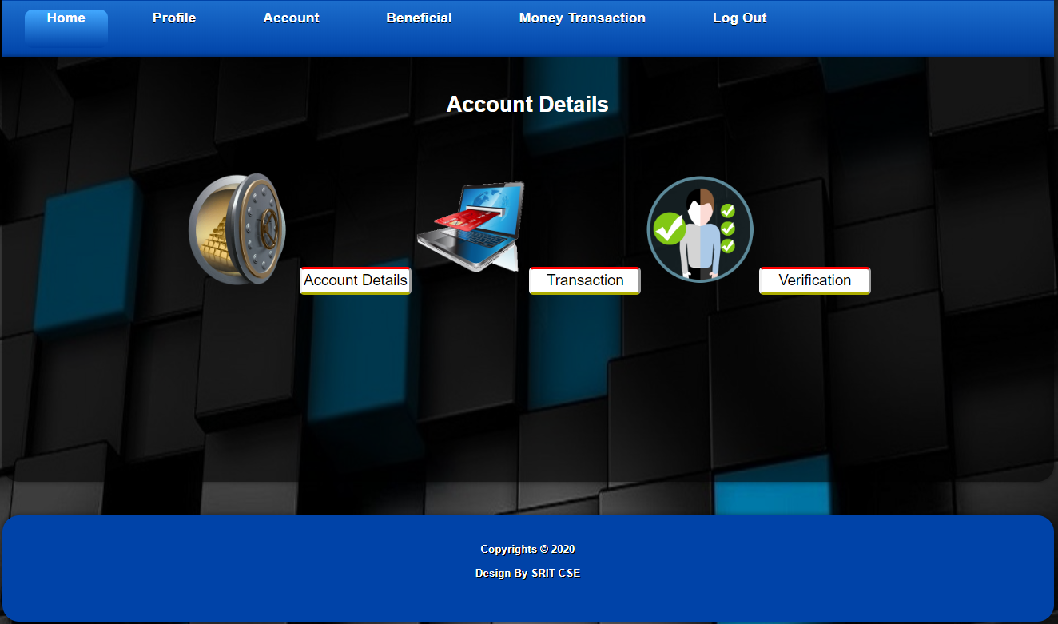
Contd..

Slide 17
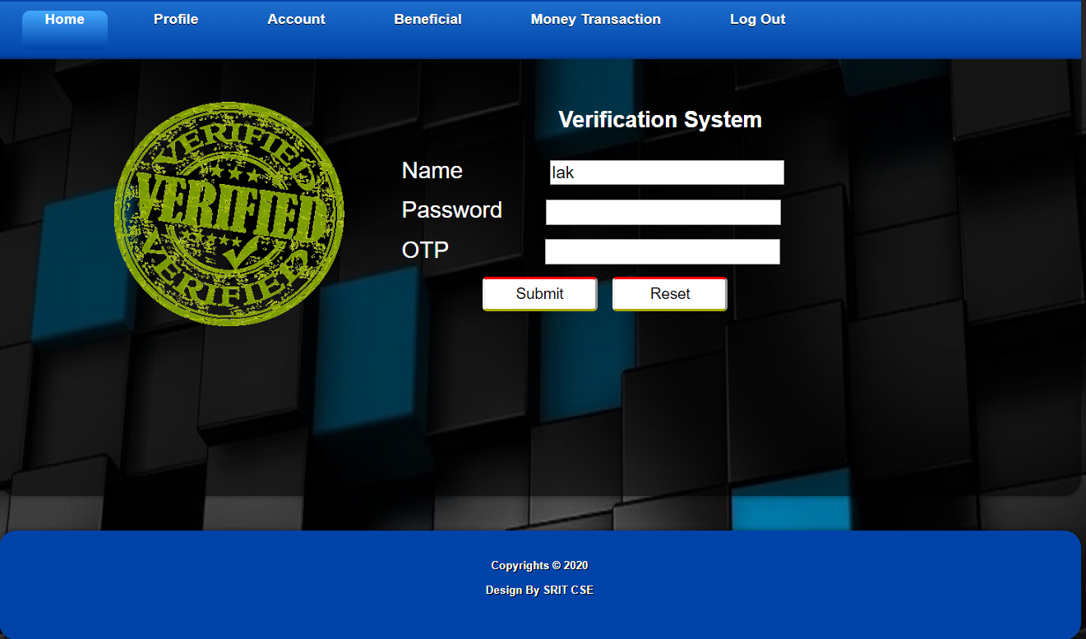
Contd..

Slide 18
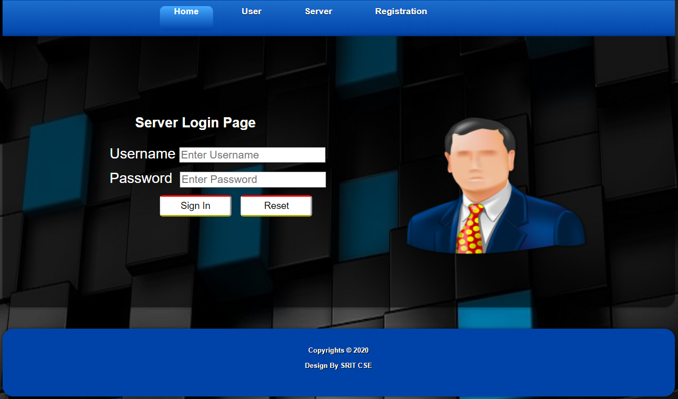
Contd..

Slide 19
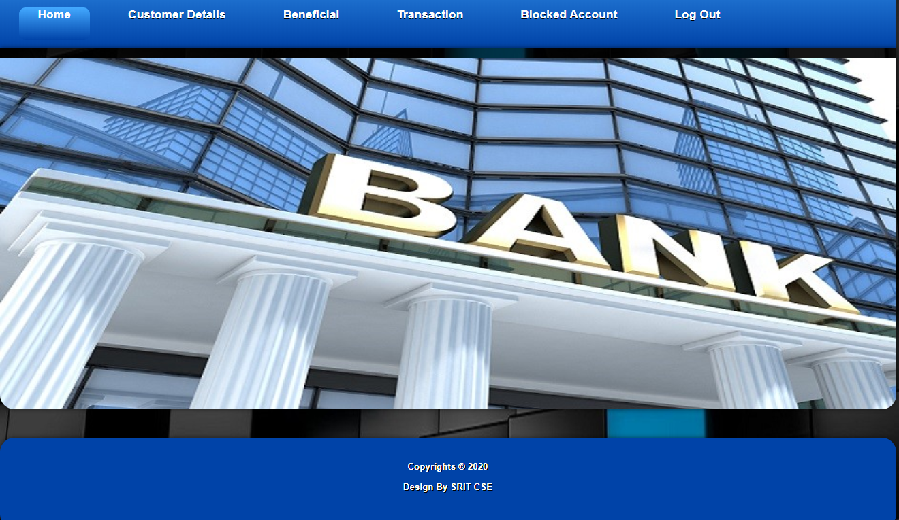
Contd..

Slide 20
Conclusion
Session management in internet services is traditionally based on username and password,We defined a protocol that supports continous authentication that improves security which approves authentication multiple times based on time.we also use image verification which is a second level verification that improves security.Finally we developed a banking application with more security.

Slide 21
References
[1]K. Pousttchi and M. Schurig, "Assessment of today's mobile banking application from the view of customer requirements," in System Sciences, 2004. Proceedings of the 37th Annual Hawaii International Conference on, 2004, p. 10 pp.
[2]Mahmoud Elkhodr1, Seyed Shahrestani1 and Khaled Kourouche2 , “A Proposal to Improve the Security of Mobile Banking Applications” 2012 Tenth International Conference on ICT and Knowledge Engineering.

Slide 22
THANK YOU
Queries
?

